Slide 1
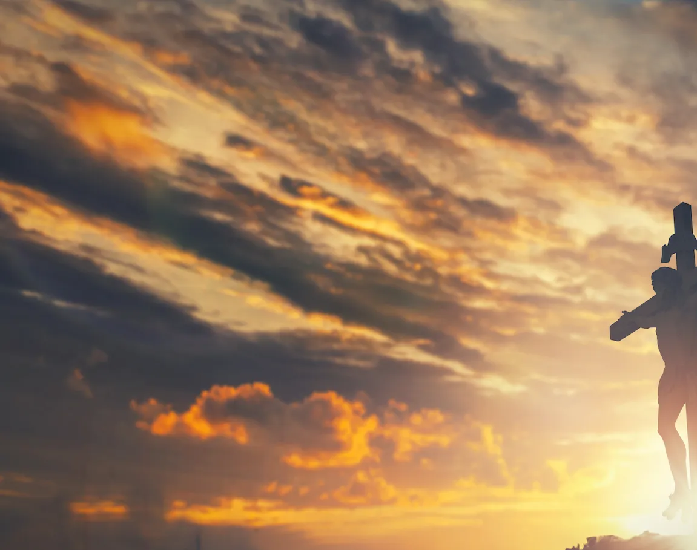
Only A Holy God

Slide 2
Bm / D / G / D
Bm D G D
Who else commands all the hosts of heaven
Bm D G D
Who else could make every king bow down
Bm D G D
Who else can whisper and darkness trembles
G A D
Only a Holy God

Slide 3
Bm D G D
What other beauty demands such praises
Bm D G D
What other splendour outshines the sun
Bm D G D
What other majesty rules with justice
G A D
Only a Holy God

Slide 4
Bm G
Come and behold Him
D A
The One and the Only
Bm G
Cry out, sing holy
D A Bm
Forever a Holy God
G A
Come and worship the Holy God

Slide 5
Bm D G D
What other glory consumes like fire
Bm D G D
What other power can raise the dead
Bm D G D
What other name remains undefeated
G A D
Only a Holy God

Slide 6
Bm G
Come and behold Him
D A
The One and the Only
Bm G
Cry out, sing holy
D A Bm
Forever a Holy God
G A
Come and worship the Holy God
x2

Slide 7
Bm D G D
Who else could rescue me from my failing
Bm D G D
Who else would offer His only Son
Bm D G D
Who else invites me to call Him Father
G A D
Only a Holy God

Slide 8
Bm G
Come and behold Him
D A
The One and the Only
Bm G
Cry out, sing holy
D A Bm
Forever a Holy God
G A
Come and worship the Holy God
END

